Slide 1
Gender Classification Using Iris Images
Group No: 10
Kedar Amrolkar
Arpita Tugave

Slide 2
Roadmap
Motivation
Previous Work
Dataset
Template Extraction
Feature Extraction Techniques And Results
Conclusion and Future Work
References

Slide 3
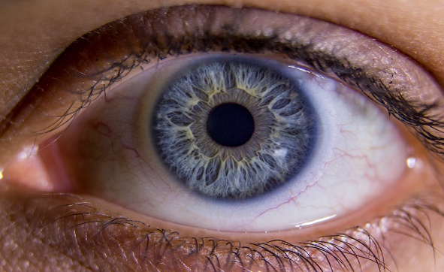
Motivation
IRIS
Surrounded by Outer Sclera and Inner Pupil
Distinctive Textural Features
Used in Identification & Verification
Accurate, reliable and widely used Biometric Traits
Use of Classification
Soft Biometrics help in Crime Investigations
Reduce Search Space and Boost Speed

Slide 4
Previous Work
Tapia et al [3] obtained 91.33% Accuracy using ULBP And SVM Classifier.
Bansal et al [1] used SVM Classifier with Gaussian Kernel function on statistical features to obtain 85% accuracy.
Thomas et al [4] obtained an accuracy of 75% with C4.5 Decision Tree Classifier using Bagging Ensemble.
Lagree et al [2] used combination of Textural detectors to obtain 62% accuracy.

Slide 5
Dataset
ND-IRIS-0405 Iris Image Dataset
University of Notre Dame
LG 2200 Iris Imaging system
64,980 Total Images
356 Subjects - 198 Male and 158 Female
Refined Dataset
1940 Total Images
194 Subjects - 106 Male and 88 Female
5 Left and 5 Right Iris Images
Cross Validation:
4 Left + 4 Right Images in Training
1 Left + 1 Right Image in Testing
5 Sets

Slide 6
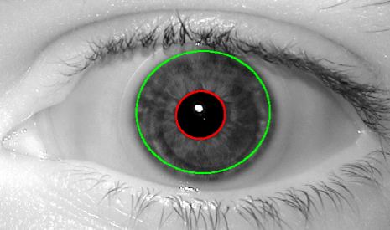
Segmentation & Template Extraction
USIT Software – University of Salzburg Iris Toolkit
Weighted Adaptive Hough & Ellipsopolar Transform
Masking Common Region of Eyelids and Eyelashes
Template Size: 360 * 30
Original
Masked

Slide 7
Feature Extraction Techniques And The Results
Textural descriptors - LBP and its variants, LPQ, GRAB, HOG, SIFT, SURF.
Machine Learning Classifiers such as SVM, KNN, Decision Tree.
Technique | Accuracy - Original | Accuracy - Masked
LPQ | 74 % | 71 %
Simple LBP | 77.57 % | 72.62 %
ULBP (50) | 86.44 % | 82.26 %
GRAB-ULBP (50) | 87.62 % | 84.27 %
ULBP + GRAB-ULBP (50) | 88.40 % | 86 %
Accuracy was higher for SVM.
Experimented for various parts of Iris.

Slide 8
Conclusion
Overlapping Windows extracts more Information.
Better Accuracy with Fusion of pixel-level Features and higher resolution Features.
Future Work
Particular Feature selection may suit better for specific Ethnicity.
Higher resolution Feature selection than Grab.
Implement CLBP instead of LBP.
Ethnicity Classification using Iris Texture.

Slide 9
References
A. Bansal, R. Agarwal, and R.K. Sharma. Predicting gender using iris images. In Res. J. Recent Sci., volume 3(4), pages 20–26. International Science Congress Association, April 2014.
S. Lagree and K.W. Bowyer. Predicting ethnicity and gender from iris texture. In Technologies for Homeland Security (HST), 2011 IEEE International Conference on, pages 440–445. Nov 2011.
JuanE. Tapia, ClaudioA. Perez, and KevinW. Bowyer. Gender classification from iris images using fusion of uniform local binary patterns. In Lourdes Agapito, Michael M. Bronstein, and Carsten Rother, editors, Computer Vision - ECCV 2014 Workshops, volume 8926 of Lecture Notes in Computer Science, pages 751–763. Springer International Publishing, 2015.
V. Thomas, N.V. Chawla, K.W. Bowyer, and P.J. Flynn. Learning to predict gender from iris images. In Biometrics: Theory, Applications, and Systems, 2007. BTAS 2007. First IEEE International Conference on, pages 1–5. Sept 2007.
Sapkota, Archana and Boult, Terrance. GRAB: generalized region assigned to binary. In EURASIP Journal on Image and Video Processing, Springer International Publishing 2013.
Kevin W. Bowyer and Patrick J. Flynn. The ND-IRIS-0405 iris image dataset. Computer Vision Research Lab, University of Notre Dame.
Christian Rathgeb, Andreas Uhl, Peter Wild. USIT Software, University of Salzburg Nov 2012.

